Slide 1
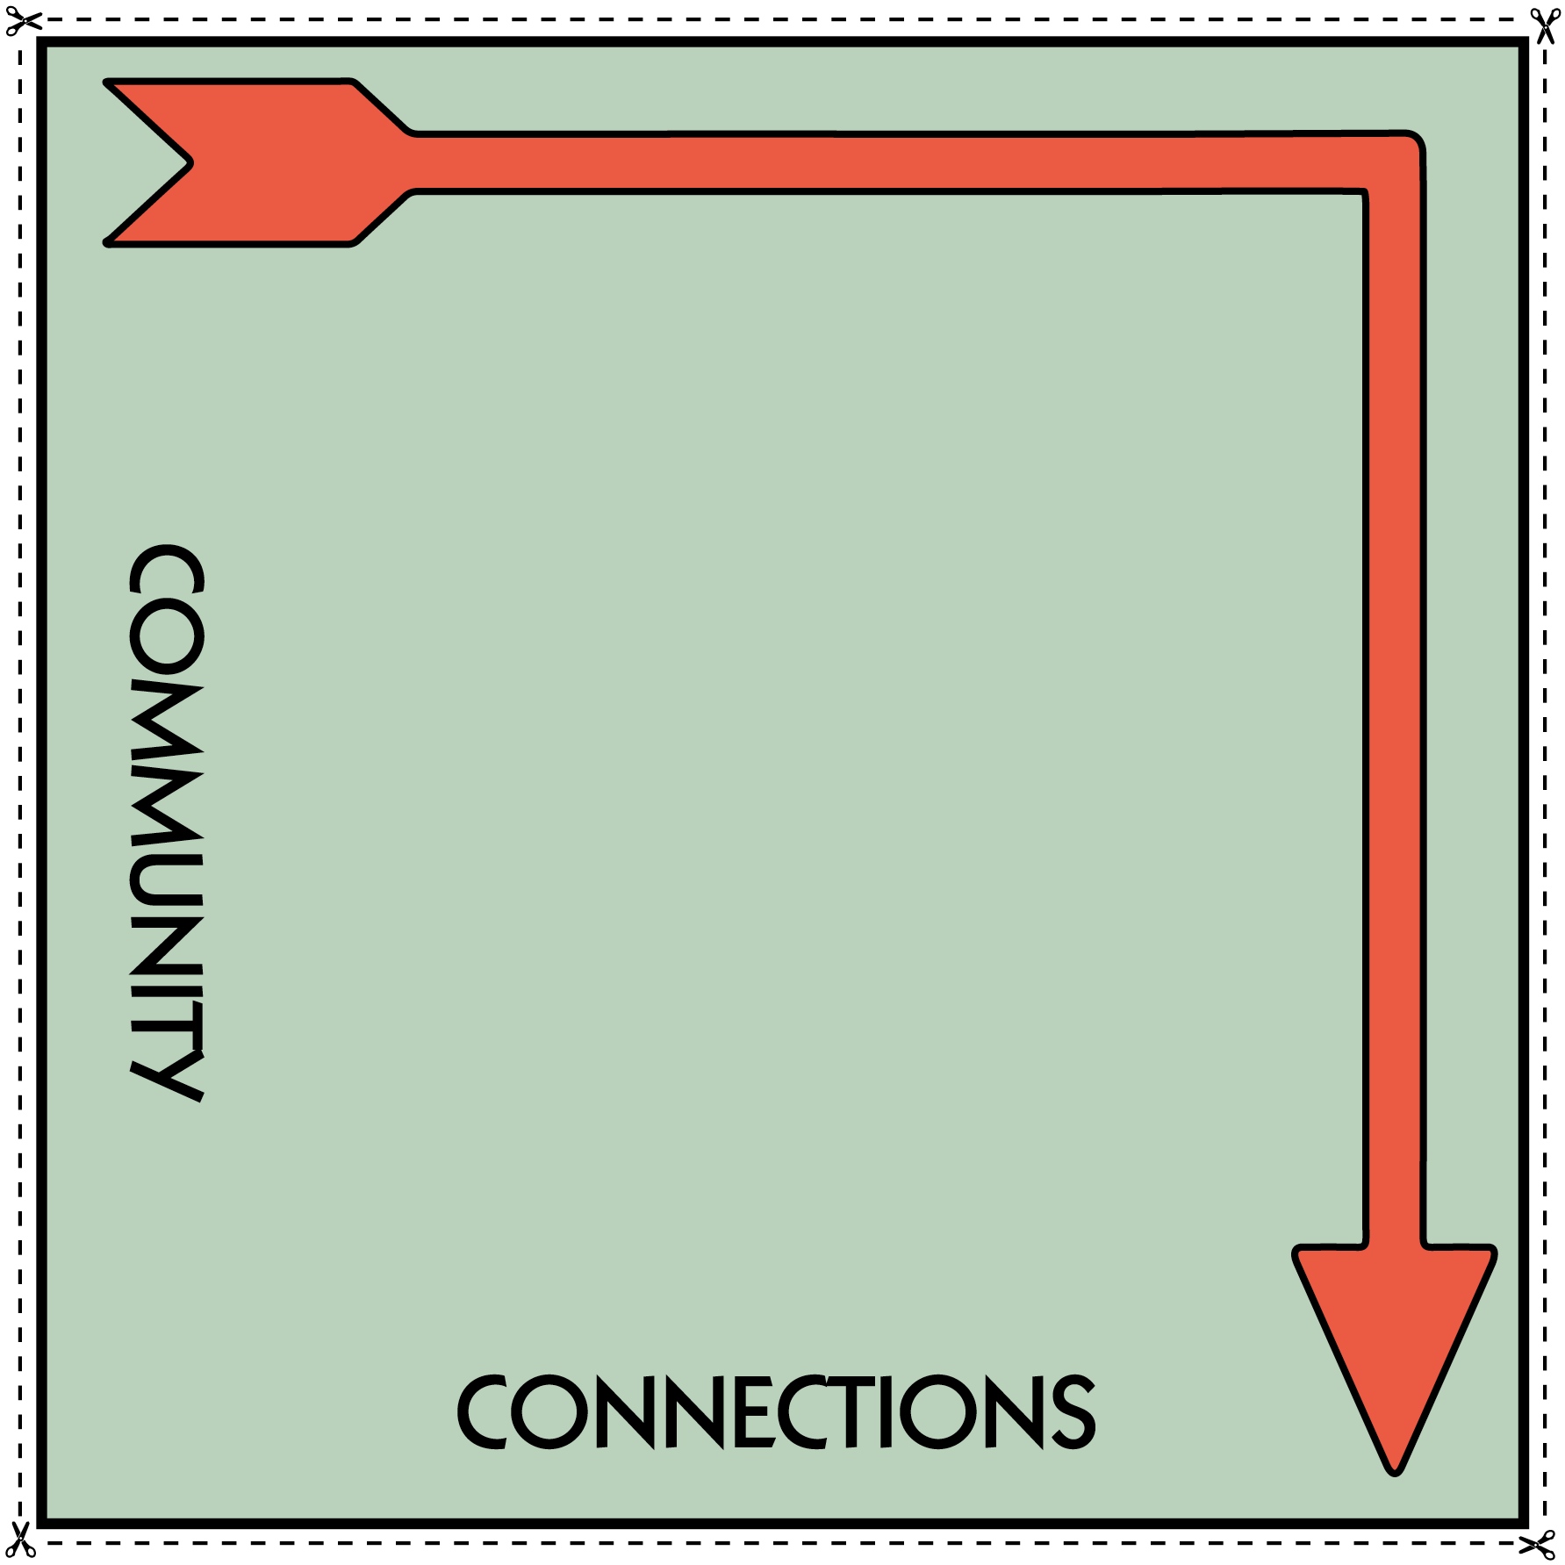

Instructions: in PowerPoint, you can insert text boxes onto the street signs to add in place names. In the blank space above the properties, you can insert images of landmarks from each area or keep blank and draw on once printed. You will need to print all the sheets in this file on A3 paper, cut each section out and piece together to create the game board.
You will need to print 4 of these to create each corner of the board and cut around the the thick black line inside the dashed line.

Slide 3
Place a text box onto the sign and write in a place name .

Slide 5
Place a text box onto the sign and write in a place name .

Slide 7
Place a text box onto the sign and write in a place name .

Slide 9
Place a text box onto the sign and write in a place name .

